Slide 1



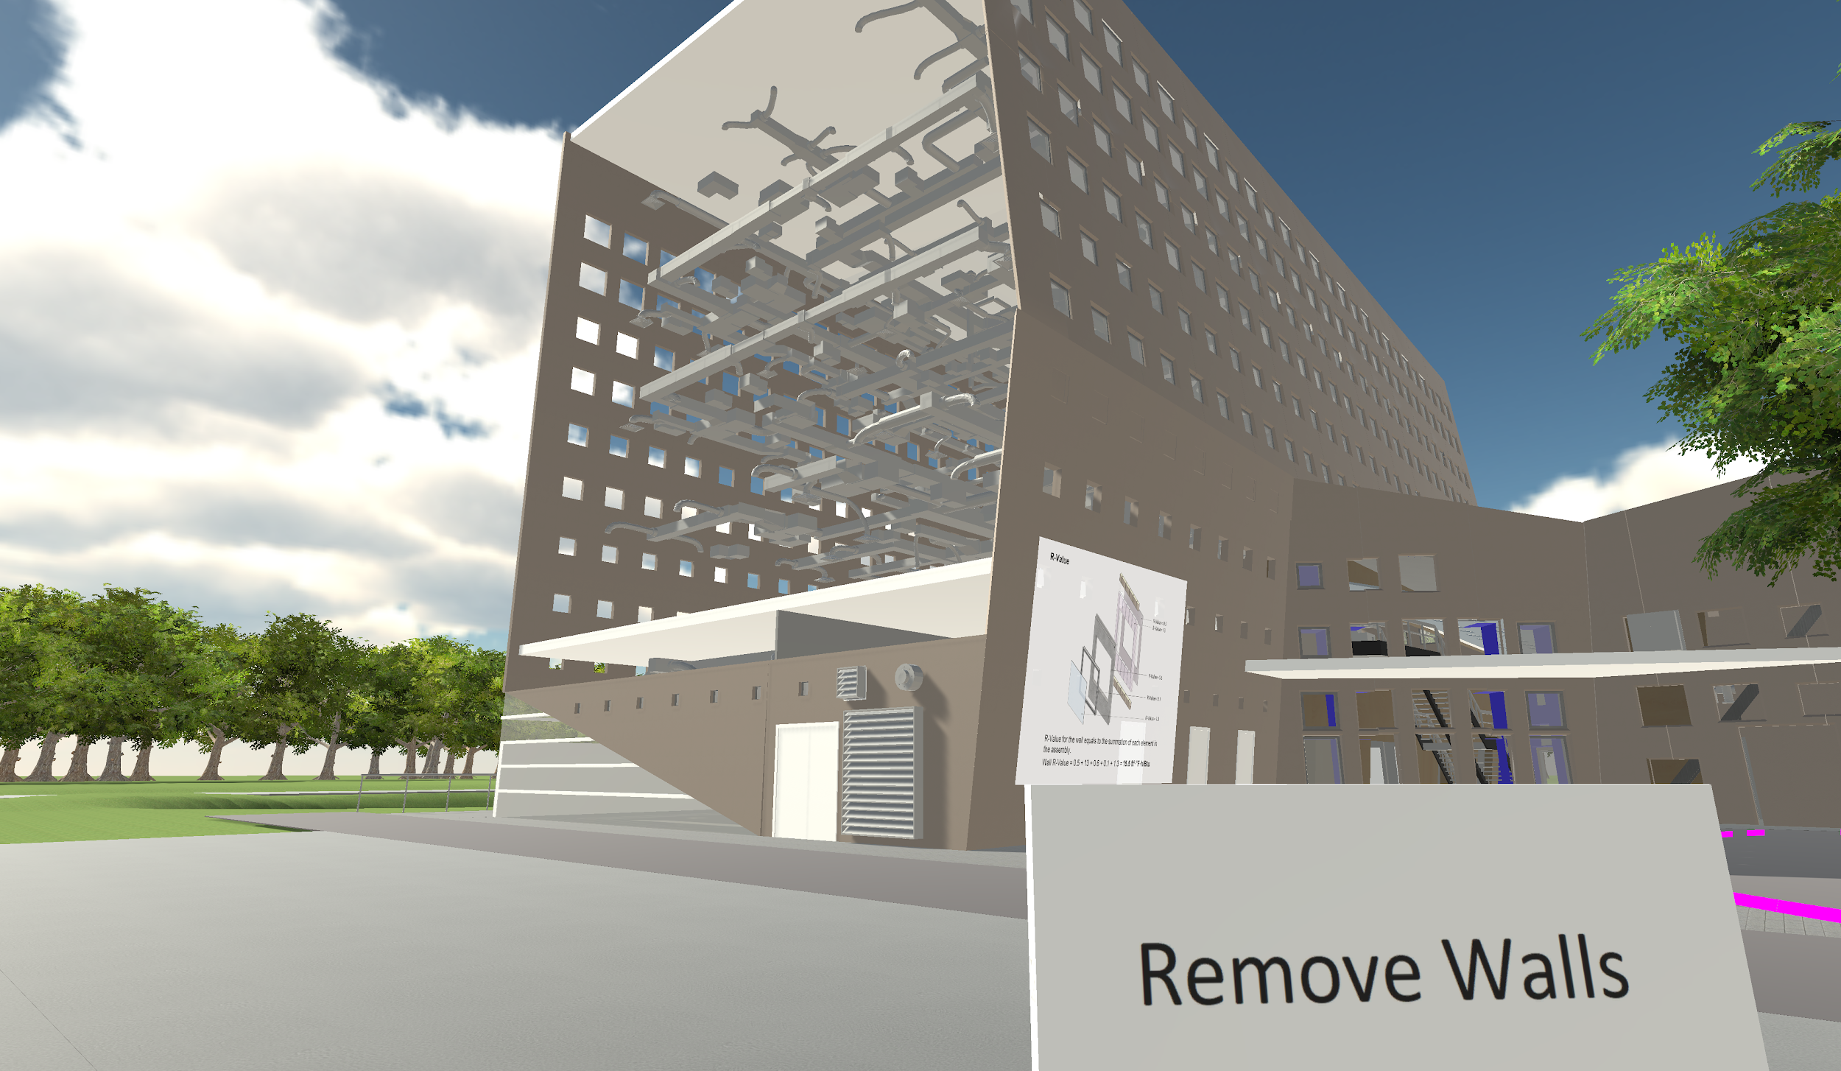
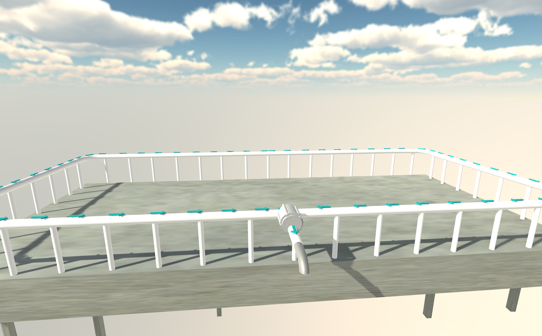
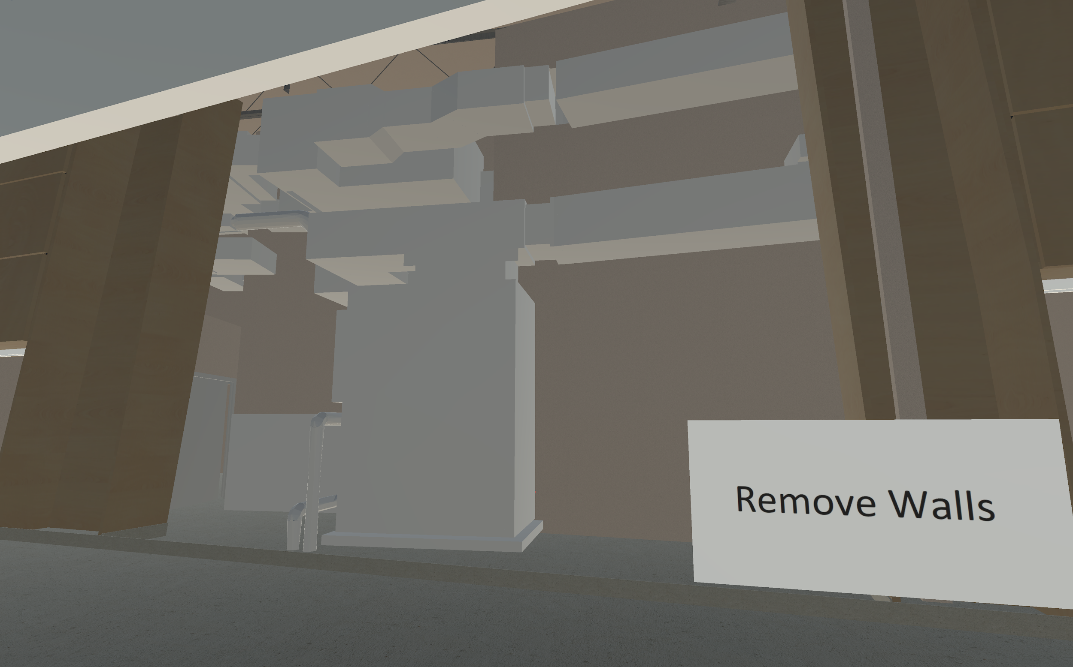
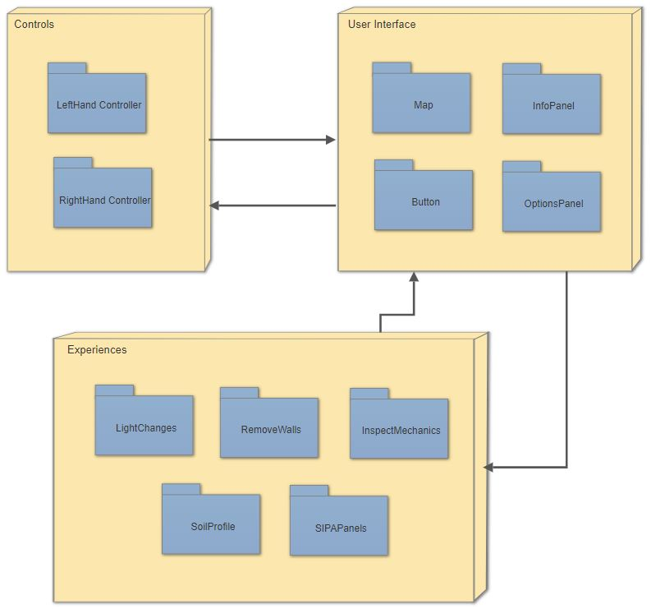


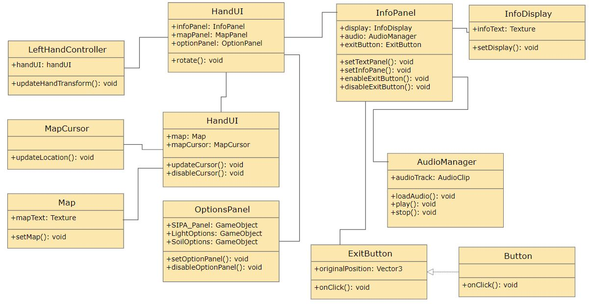
School of Computing & Information Sciences
Senior Project, 2018, Spring
Learning with Virtual Reality 5.0
Student: Jerry Pujals, Florida International University
Mentor: Shahin Vassigh, Architecture professor
Professor: Masoud Sadjadi, Florida International University
Problem
The remove wall feature is not fully implemented
The viewing angle and area for the soil animation is not well implemented
A wall needs to be removed to be able to view the elevator machines.
Solution
Fix the remove wall to allow the user see the ventilation system.
Move the animation to a area where it is the main focus and can be seen easily
Use the system for removing other walls to do the same with the elevator wall.
Current System
The button is moved to a area where the user can be able to see the change in the wall and glows when looked at.
The animation is in a void to be able to be focused.
The wall disappears next to the button to reveal the mechanics.
ScreenShots
Requirements
Informative and easy to understand models with accompanied text.
A intuitive and simple interface for the user to use that won't make them confused or sick from vr.
User is able to follow a tour that will explain the workings of the building.
A computer that can run a VR oculus headset.
System Design
Implementation
Main program: Unity
Backend: C#
Using OVR api
Verification
TestCase Id: Learning_vr_5.0_319 (Sunny)
Purpose Let the user easily see the ventilation
Get the user to know to push the button
Input User pushes button
Expected output Wall disappears
The button glows
Object Design
Summary
Users can explore the SIPA building in virtual reality and view information about its architecture.
Users can see the inner workings of the finished building in a presentable manner.
Acknowledgement
The material presented in this poster is based upon the work supported by … I am thankful to the help that I received from my group members, … .
Notes:
‹#›

